Slide 1
Feeding cows in tough times…
Notes:
AS90831
Resources: Whiteboard & pens, tea/coffee and biscuits, Clear tech bottles, A3 paper, handouts – Dairy Tomorrow, Water Quality, Powerpoint, Pics of Aqua Flex

Slide 2
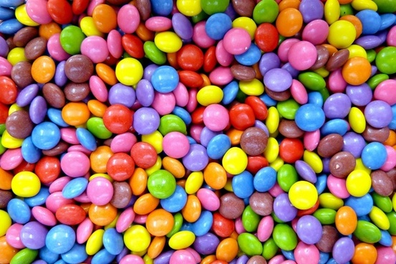
Kentucky cows chow down on candy (2012)
https://money.cnn.com/2012/10/10/news/economy/farmers-cows-candy-feed/
For each statement, place a tick in either the “agree” or disagree column.
Be prepared to support and defend your opinions with specific examples.

Slide 3
Starter: Look at the following statements and tick agree or disagree…
Agree | Disagree | Statement
 |  | It is not bad for cows to be feed sweet foods like candy.
 |  | Feeding cows food factory seconds helps decrease the amount of waste.
 |  | Feeding cows processed sweets happens in New Zealand.
 |  | It is not healthy for cows and has animal welfare implications.
 |  | If candy is good enough for humans it is good enough for cows.
 |  | You are what you eat. The milk or meat from a cow will not be as nutritious.
Lets look at an article that was published on CNN. https://money.cnn.com/2012/10/10/news/economy/farmers-cows-candy-feed/
As you read through the article think about the pervious statements. Write a ‘A’ in the Reading box if you think the article agrees with the statement and a ‘D’ if you think the article disagrees with the statement.

Slide 4
Situation in New Zealand…
“More generally, feeding cows such food as Skittles was not an issue in New Zealand because unlike the US, Europe, UK and Australia, ruminants in this country were almost exclusively fed a pasture-based diet,” Gibbs said.
That provided ample nutritional advantages for both cattle and sheep. New Zealand had the lowest rate of dairy cow health events in the OECD.
"Milk and meat grown on grass has higher polyunsaturated fats and much higher omega 3 group fats."
AgResearch animal nutrition science team leader Dr David Pacheco said he had heard of New Zealand farmers who occasionally fed their cows confectionary, as well as vegetable and fruit waste.
It was not a problem but as with all foods rich in fermentable sugar, such as molasses and fodder beets, care had to be taken.
When the microbes in the cows rumen (first stomach) ferment food with easily accessible sugar, too much acid could be produced and the animal could get sick with a condition called acidosis.
https://www.stuff.co.nz/business/farming/88779383/some-nz-cows-get-sweet-treats-but-nowhere-near-as-much-as-their-us-cousins

Slide 5
It is crucial that animal welfare, environmental health and the economics are factored into decision making. What cows eat has a big impact on all three factors.

Slide 6
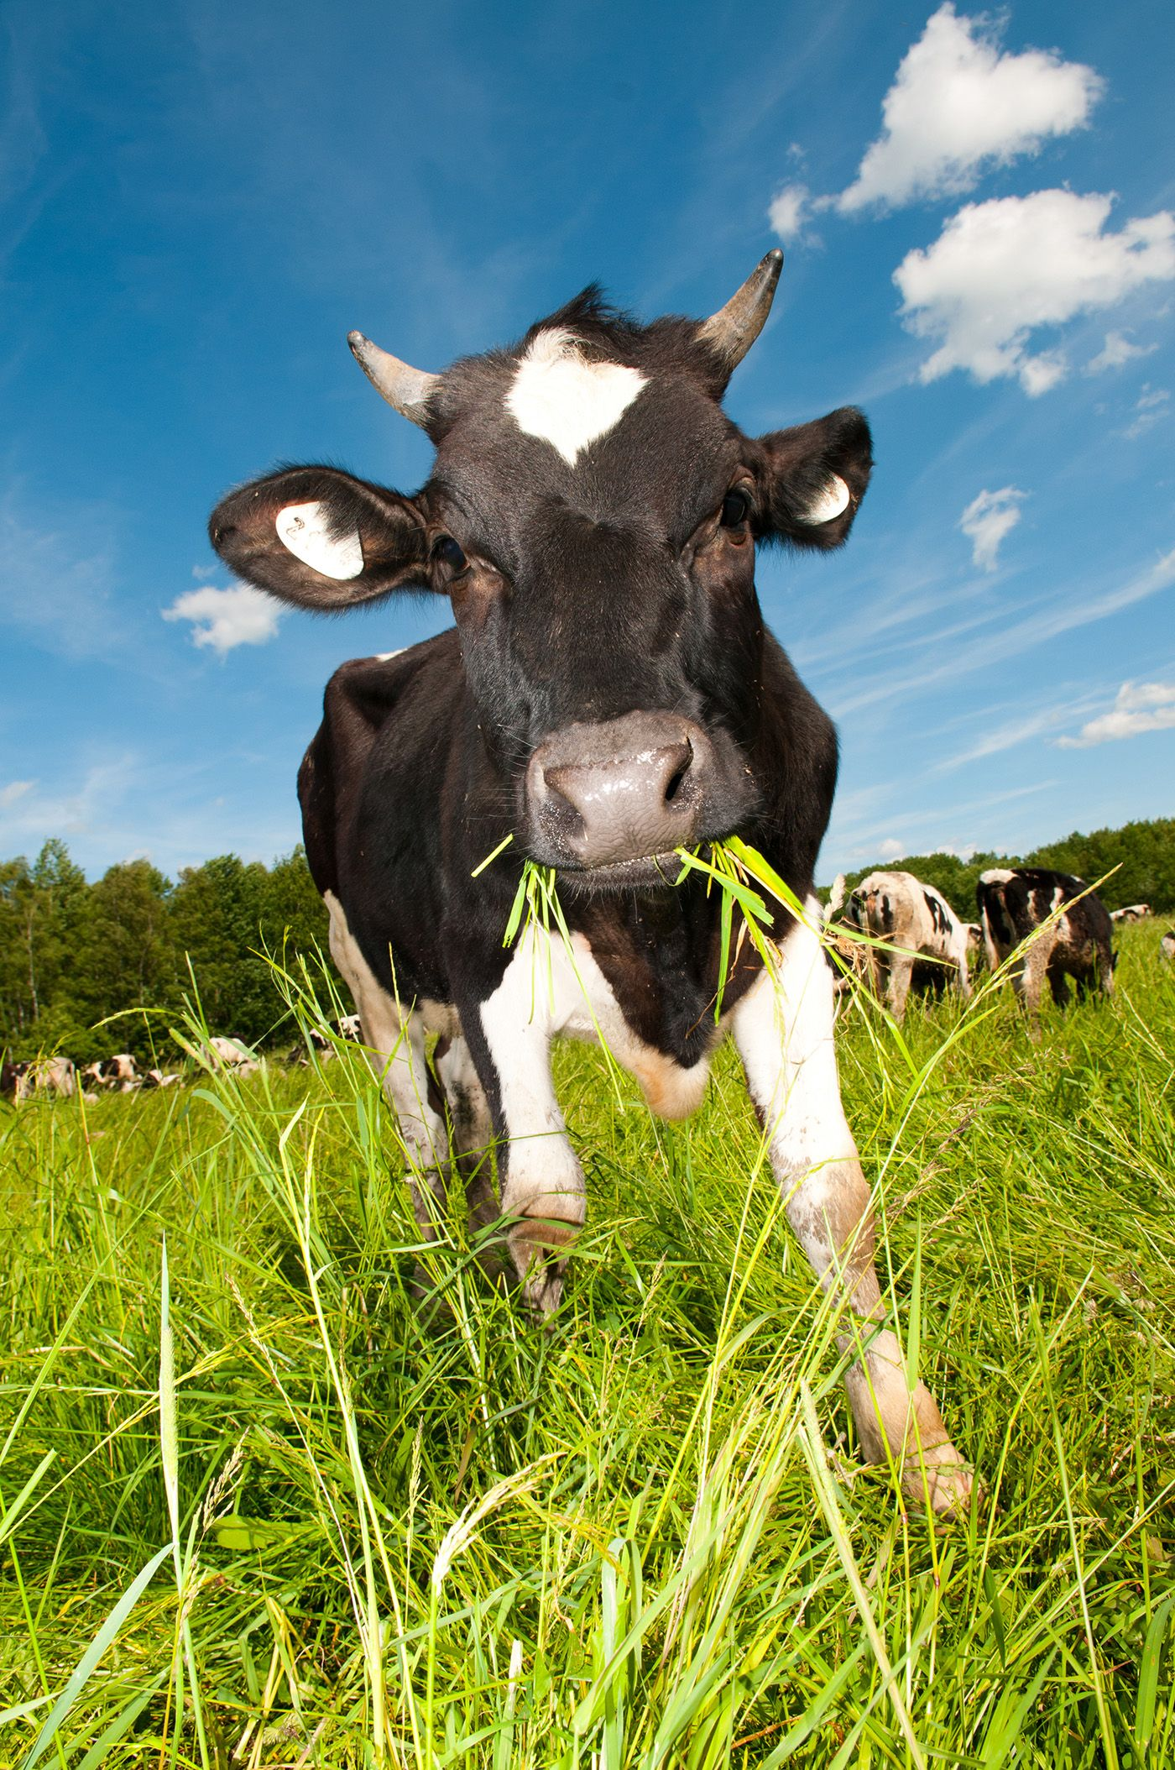
What is the main feed that cows eat in New Zealand?
There are lots of different types of grasses but the ones you are most likely to see in a dairy paddock is ryegrass and clover.
Benefits…
- grass absorbs carbon,
- protects soil from wind erosion,
- provides habitat for soil organisms,
- is cheap to grow,
- is very nutritious to cows
- provides cows with most of their water.
But there are a few issues that farmers face when growing grass…

Slide 7
Graph the following data…
Month | Pasture Growth kgDM/ha/day | Feed Demand kgDM/ha/day
June | 16 | 20
July | 27 | 30
August | 40 | 45
September | 60 | 55
October | 71 | 52
November | 61 | 58
December | 42 | 42
January | 27 | 38
February | 25 | 35
March | 38 | 29
April | 33 | 23
May | 28 | 20
Values are an approximation. They would vary depending on region and the yearly variations in weather.
Key Events
July/August = calving
October = mating
May = drying off (stop milking)
Notes:
Cows are not seasonal breeders like sheep/ goats so can breed throughout the year, however farmers mate cows so they calve at spring when there is plenty of feed/grass that is also high quality.

Slide 8
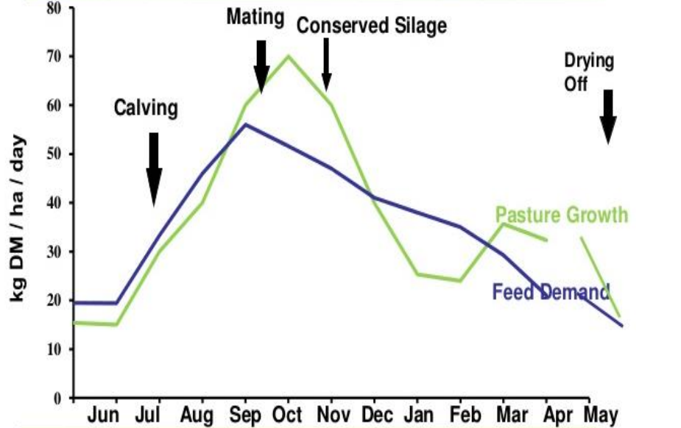
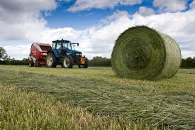
Pasture Growth and Dairy Cow Requirements.
Write a sentence explaining what is happening with feed for each season (winter, spring, summer, autumn).
Notes:
John Alabi Bozinviya, 2019, “Supplementing grazing dairy cows with crops: fodder beet and oats, to improve milk production and nitrogen utilization”, accessed 2021, https://researcharchive.lincoln.ac.nz/bitstream/handle/10182/11437/Alabi_John_PhD_Closed.pdf?sequence=5&isAllowed=y

Slide 9
Different ‘classes’ of stock and their needs.
Different animals require more food depending on their needs. Farms often have a large range of stock that they need to manage to ensure all animals are healthy and well cared for.
1. What do you think is meant by “maintenance” energy and requirements?
2. Sort the different animals into the two categories.
dry dairy cow (not milking)
lactating dairy cow (producing milk)
calf
bull
early pregnancy dairy cow
late pregnancy dairy cow
“Maintenance” Energy and Nutritional Requirements | High Energy and Nutrient Requirements
Notes:
Maintenance is the amount of feed that an animal needs to maintain that weight/ body condition score. Feeds used to ‘maintain’ stock does not have to be high in energy content.
Maintenance = dry cow, bull, early pregnancy
High energy = lactating cow, late pregnancy, calf
Good protein input is necessary for growth (10-14% dry matter (DM)) and lactation (15-18% of DM). Recommended protein requirements for maintenance are 6-8% of DM.

Slide 10
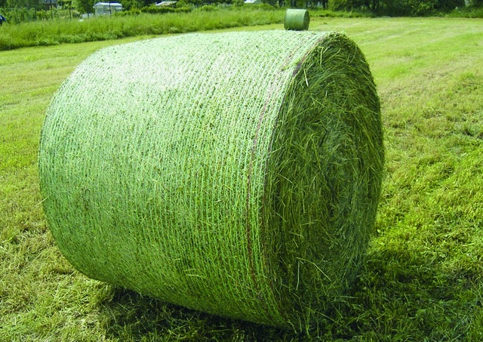
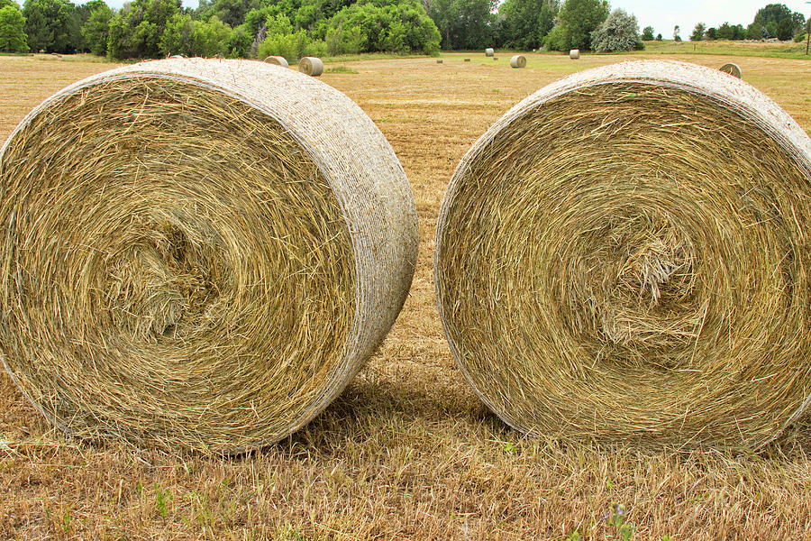
Grass doesn’t grow consistently so we must figure out a way to feed cows over the year…
Excess grass can be cut and stored as silage and hay.
Crops can be grown in summer and feed out in winter. There are some crops that can still grow in winter. So they can either be feed out to stock using break feeding (in sections) or harvested to be feed out later.
Crops can also lead to environmental impacts like pugging (the compaction and destruction of soil structure), increased erosion and can lead to an increase or decrease nitrogen leaching.

Slide 11
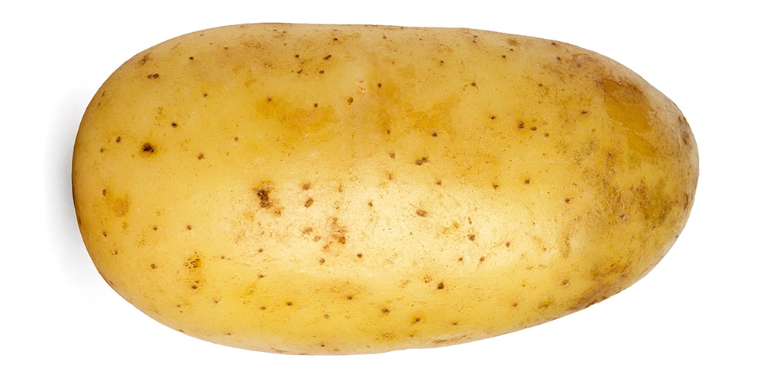
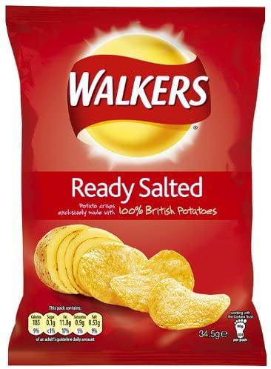
DM what is it….
DM stands for dry matter. This is what is left after all the water has been removed from the plant. DM can vary quite a bit with fresh pasture up to 90% water, while cereal grains and hays could be 10% water.
The DM (kg) holds the nutrients and energy. So a DM value gives a guide on how much feed is available, the quantity.
The energy value tells how nutritious a feed is, the quality. It is expressed as megajoules of metabolisable energy per kilogram of dry matter (MJME/kg DM).
So you can figure out how much feed is available or how much food to supply using these two measurements.
A potato is 80% water, when you create chips you remove the water and fry it leaving the DM. One potato makes one bag of chips, which one could you eat more of?

Slide 12
It is important that the cow’s energy needs are meet or else she will lose weight and ‘condition’. A cow’s rumen is around 50L, this translates to an approximate capacity of 20kg of dry matter per day. A cow will struggle to consume more than that due to stomach size.

Slide 13
Read the different feed cards then complete the following…
Note: The cost for feed is just the cost involved in either putting the crop in and/or the processing of the crop/ pasture with contractors. This does not include the cost of reseeding paddocks after crops, fertilisers, lime etc.
Organise the cards in the following. Highest total energy available (MJME/kg DM) to lowest total energy available.
Calculate the cost of feed for a herd of 500 cows for each feed type. Remember the maximum amount of feed one cow can consume is 20kgs DM.
What is the difference between crops and pasture in regards to ‘cost’, ‘environmental impact’ and ‘animal welfare’.
Complete the two tasks on the “Feed Evaluation”handout.
 | Differences Between Crops and Pasture
Environmental Impact
Animal Welfare
Cost

Slide 14
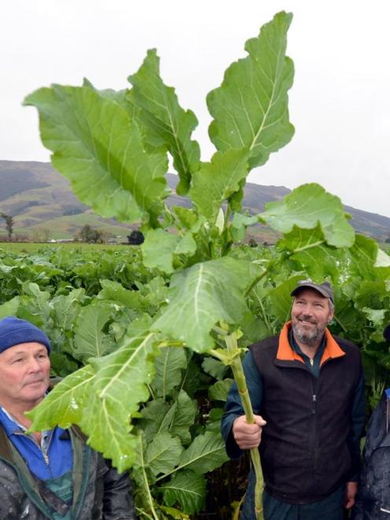
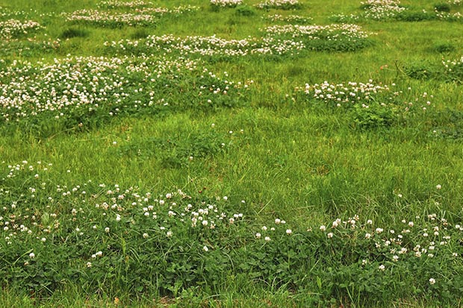
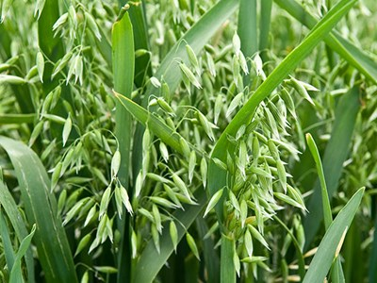
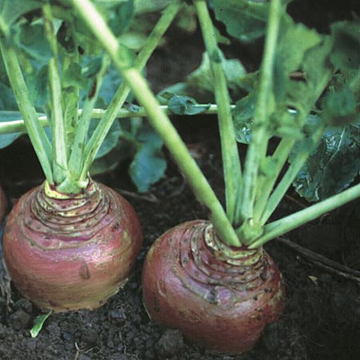
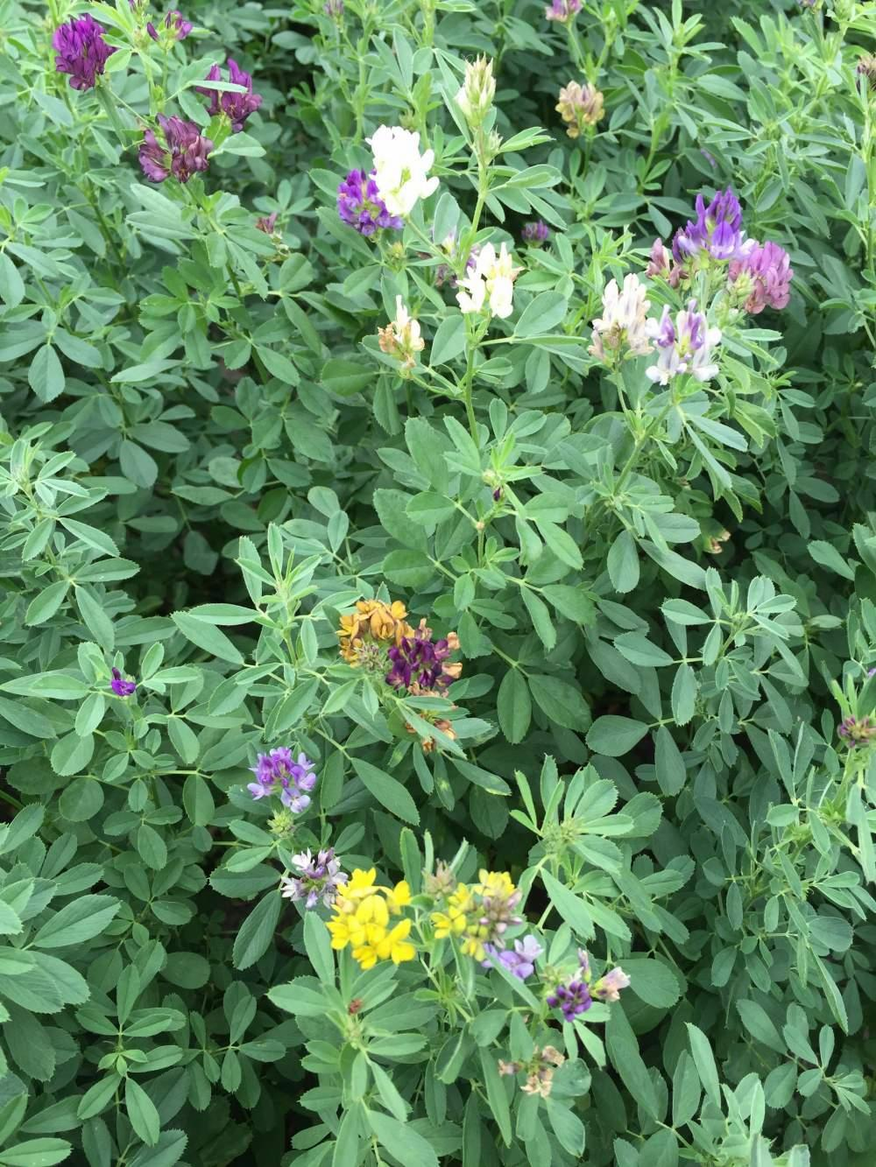
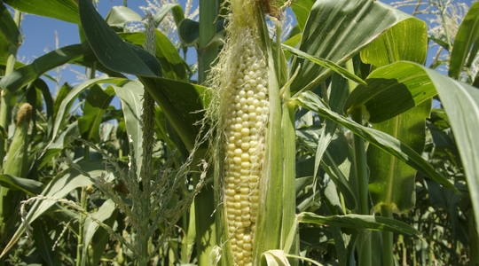
Close: Look at the following pictures, can you identify the different types of feed. Options: Oats, Kale, Maize, Hay, Lucerne, Swedes, Silage, Pasture
A)
C)
D)
B)
E)
F)
H)
G)
Notes:
A= Silage bale (before being wrapped),
B = Oats (often sown after break feeding a crop in winter as they can grow in cold conditions and help to soak up the nitrogen in the paddock, left over from urine patches)
C= Kale
D = Clover and ryegrass (the most common pasture mix for Dairy)
E = Swedes
F = Lucerne (long tap root and nitrogen fixer = fixes nitrogen from the atmosphere into the soil)
G = Maize (like sweetcorn but not as sweet, can also be harvested and made into silage)
H = Hay (dried grass that is not wrapped up and instead stored in a barn/ shelter)

Slide 15
Answers
A | Silage
B | Oats
C | Kale
D | Grass (Ryegrass and Clover mix)
E | Swedes
F | Lucerne
G | Maize
H | Hay

