Slide 1
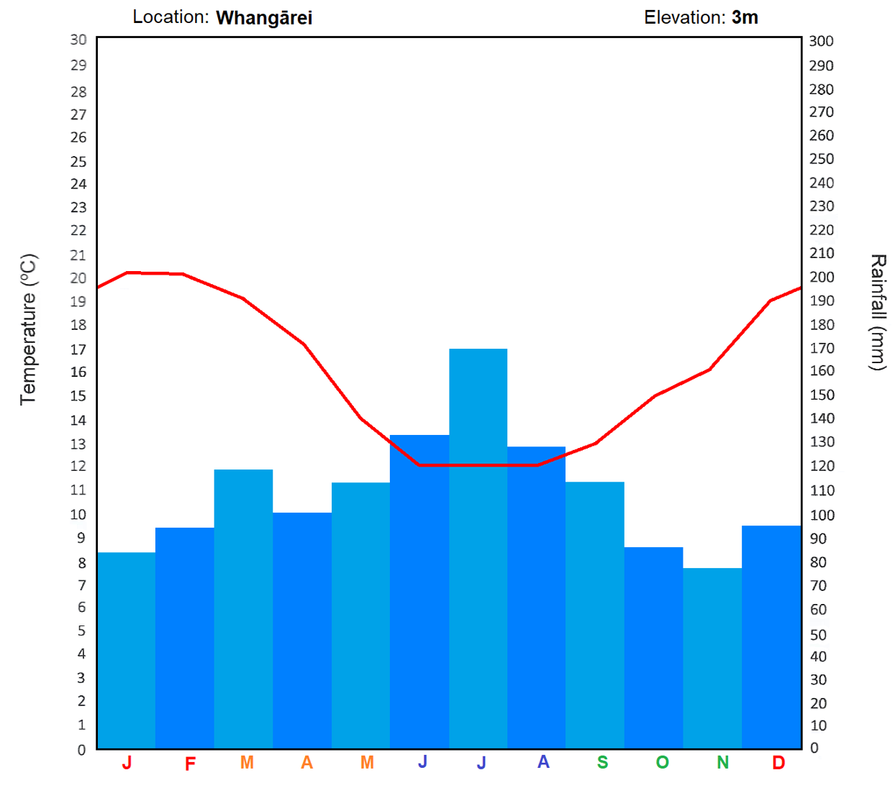
Seasonal Variations
1. Good grass growth needs around 80ml/ month. Analysis each of the seven climate graphs and determine what months of year would each region struggles to produce grass and for how many months.
2. Then order the regions from longest growing seasons to shortest.
3. Discuss how climate change may affect the viability of some farms.

Slide 2
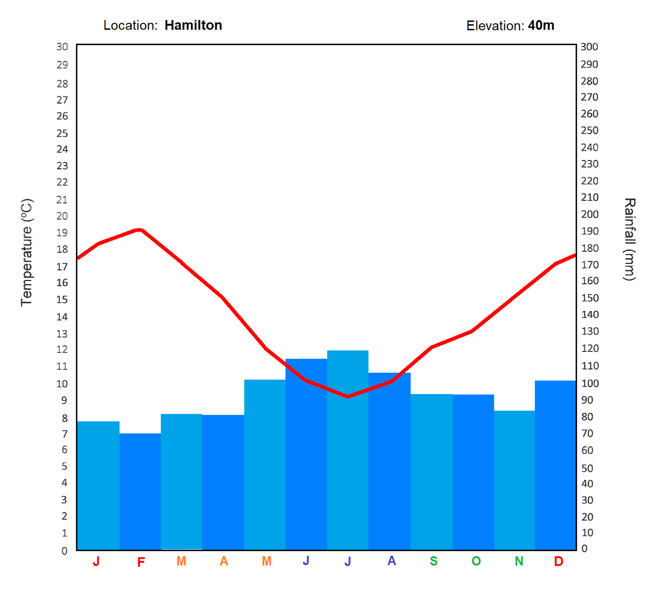
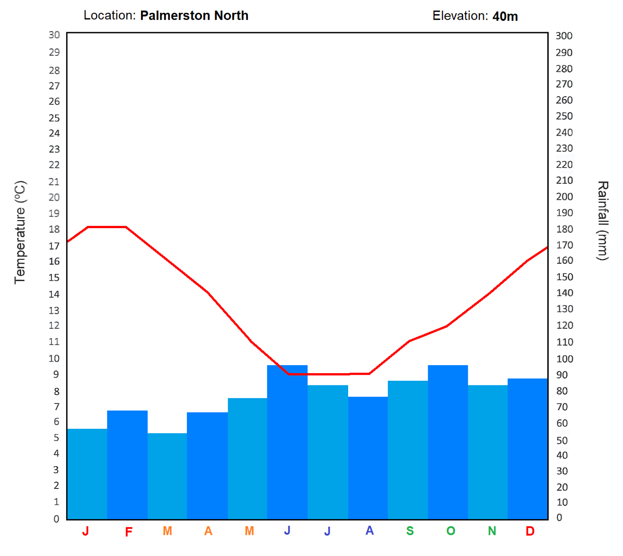

Slide 3
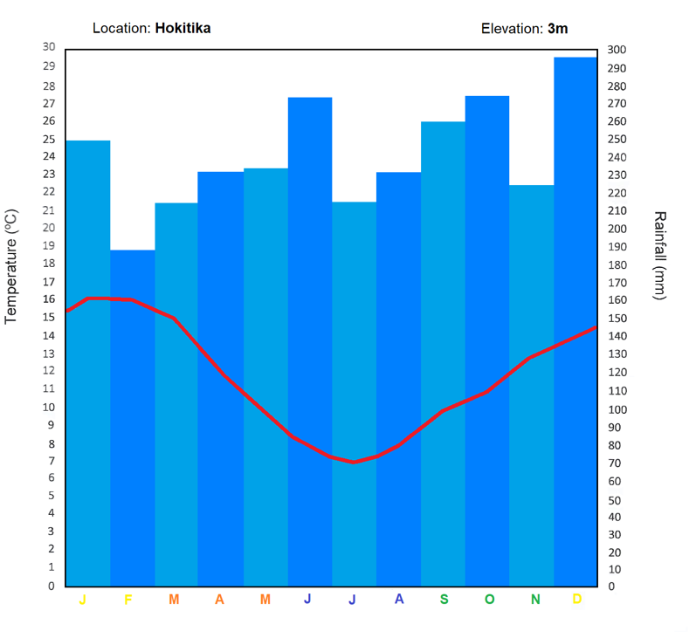
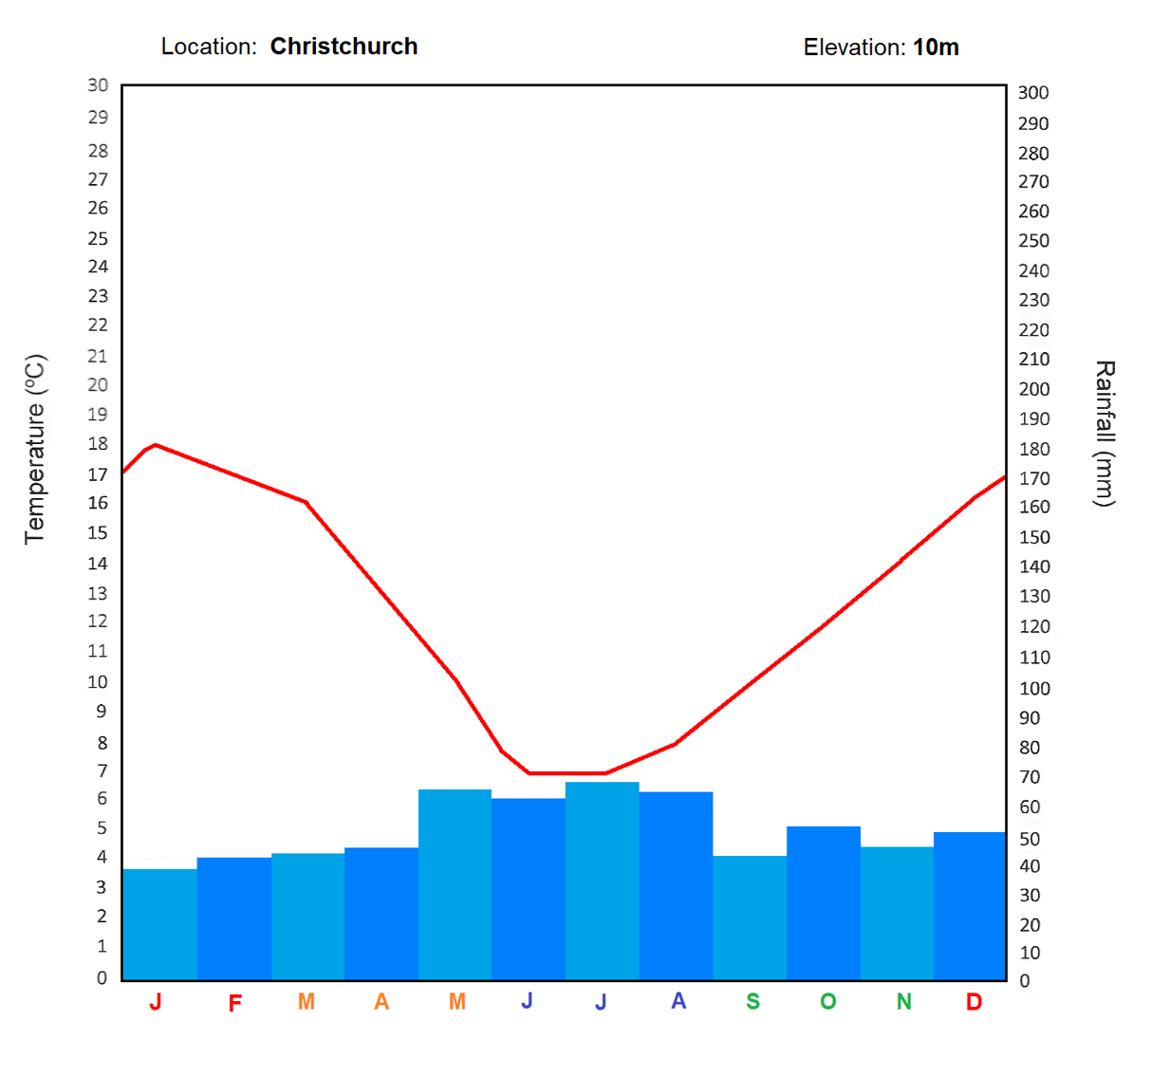

Slide 4
